Slide 1
CA1 PART B
Haaris Sulaiman P2112815

Slide 2
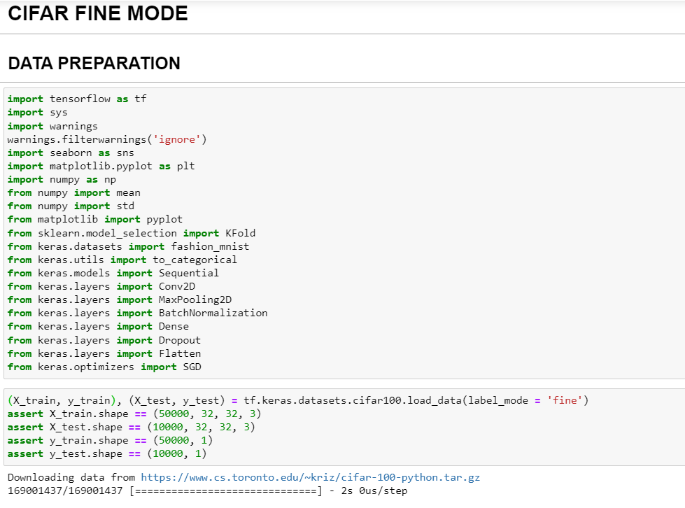
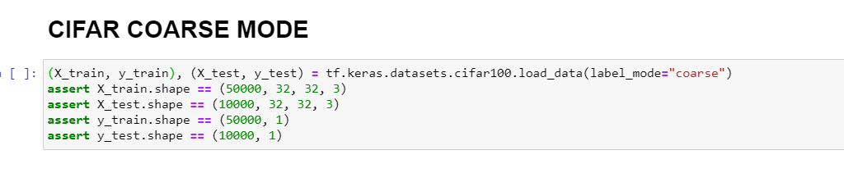
DATA LOADING

Slide 3
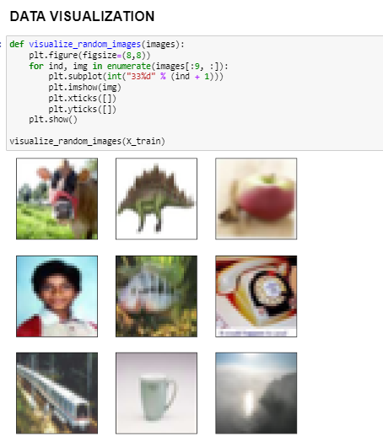
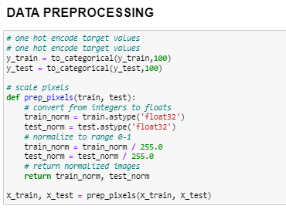
DATA PREPROCESSING AND VISUALIZATION

Slide 4
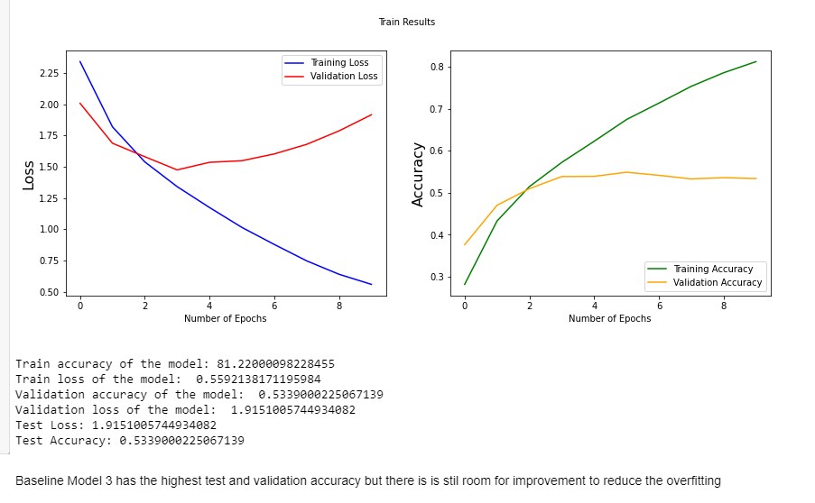
BASELINE MODELS
FINE MODE: MODEL 3
TRAIN ACCURACY: 72%
TEST ACCURACY: 40%
COARSE MODE: MODEL 3
TRAIN ACCURACY: 81%
TEST ACCURACY: 53%

Slide 5
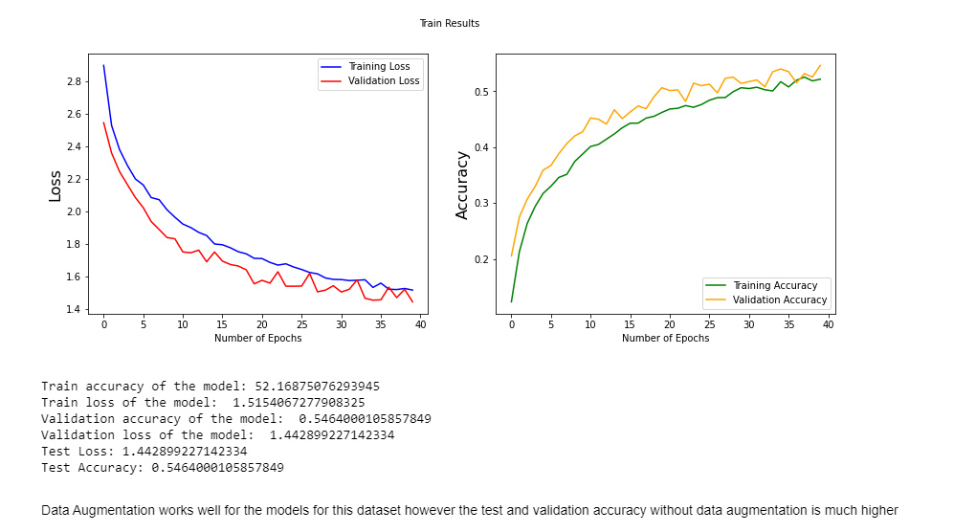
MODEL IMPROVEMENT
FINE MODE:
DROPOUT:
TRAIN ACCURACY: 47.2%
TEST ACCURACY: 42.4%
DATA AUGMENTATION + DROPOUT:
TRAIN ACCURACY: 20.1%
TEST ACCURACY: 24%
COARSE MODE:
DROPOUT:
TRAIN ACCURACY: 69.4
TEST ACCURACY: 59.1%
DATA AUGMENTATION + DROPOUT:
TRAIN ACCURACY: 54.6
TEST ACCURACY: 54.6

Slide 6
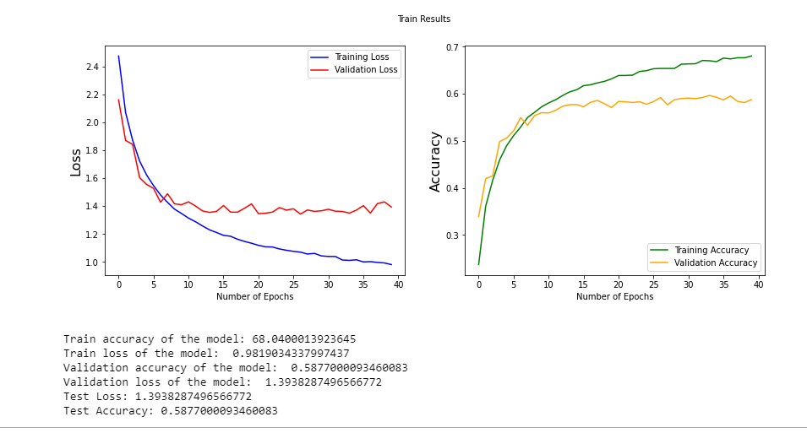
FINAL MODEL
FOR CIFAR FINE MODE:
Baseline Model 3 + Dropout
Train Accuracy: 52.6%
Test Accuracy: 44.6 %
FOR CIFAR COARSE MODE:
Baseline model 3 + Dropout
Train Accuracy: 68%
Test Accuracy: 58.8%

Slide 7
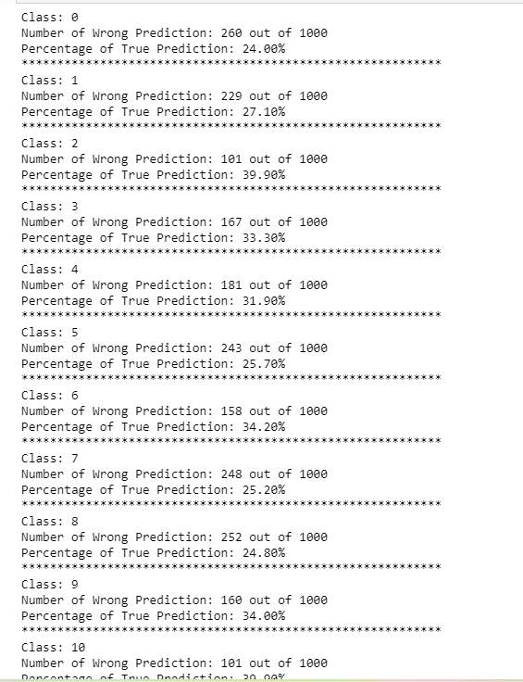
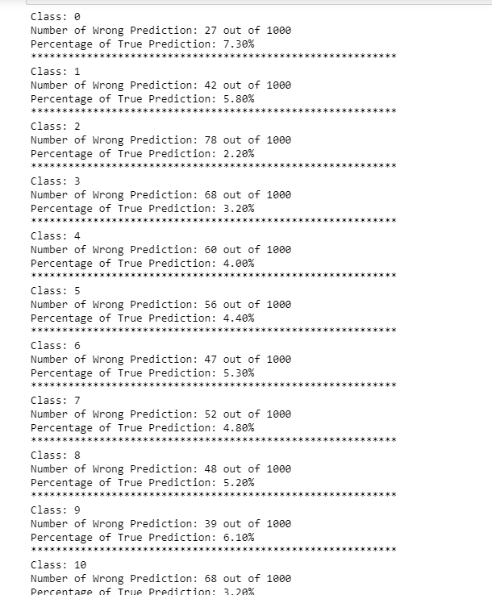
PREDICTIONS

